Slide 1


NavBot – Team 8

Slide 2
Problems Tackled
Problem:
There is a high demand for support and a limited amount of staff.
- leads to people waiting in queues to
get help
Problem:
Data sources available :
-lack of developers hence it is difficult to
utilise sources to the maximal potential
We have produced a possible development to the website to give the user a more personalised experience. Our process ensures the user is left satisfied with the support offered.
Problem:
Large number of users visiting a single page and exiting the site
-lack of personalised experience and
uncertainty over whether the
information helped

Slide 3

Demo
Process:
User enters site, mostly through entering problem into search bar
User will read article, there will be a scrolling chat box on the side
Chatbox, Macs, will open when the user has not had the problem resolved
Macs will navigate the user to various options for support by chatting to the user

Slide 4

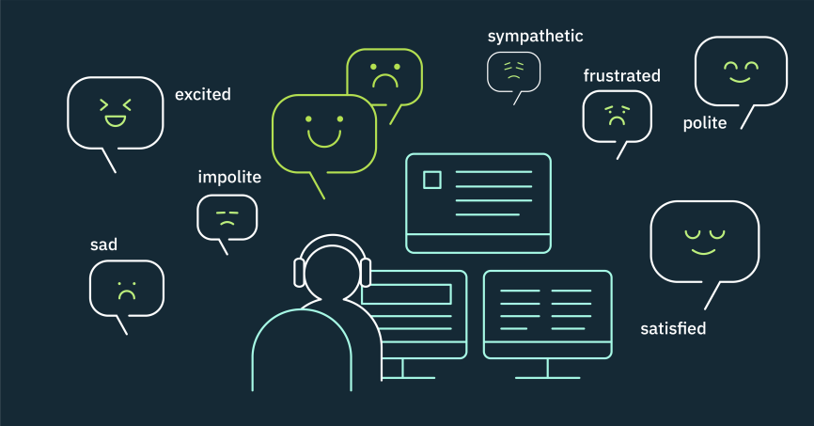

Technical information
Keyword Category mapping: specific words input matched with the same words used in articles/forums.
http://www.controllersgroup.net/five-tips-mapping-career-path/
Tone Analysis/Natural Language Processing(?): Detects tone of the user eg. looking at the length of reply
https://www.ibm.com/blogs/watson/2017/07/ibm-expands-watson-tone-sensitivity-for-customer-service/
https://digitalagencynetwork.com/near-me-searches-google/
NHS open data: Using user’s location to offer more informative support eg. nearby centres.

Slide 5

How will our product make a difference?
We realised that looking that the website provided two routes for a user to follow: Read from over 2 000 articles available or call/message an SMS crisis helpline .
We concluded that these are the two opposite ends of the spectrum when considering what a Young Person wants.
This idea of a tailored service, Macs, provides a bridge to this gap.

Slide 6
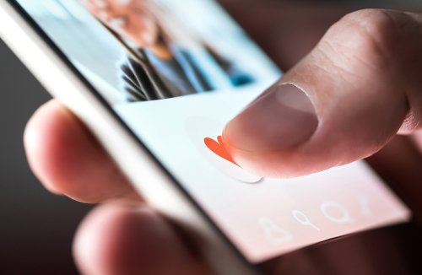
What differentiates this development?
Provides full interaction with the user without requiring a staff member
User can input their email at the end of the chat to refer back to the links another time, this chat will be deleted from system to provide the anonymity most young people would want

Slide 7
Thank you for listening

